Slide 1
Farm2Store
Presented By:
Lodha Dhruvil
Sadhu Chirag

Slide 2
Acknowledgement
We Are Pleased To Present This Platform, A Revolutionary Tool Designed To Connect Farmers Directly With Retailers, Eliminating The Need For Intermediaries And Enhancing The Efficiency Of The Agricultural Supply Chain.
We Would Like To Express Our Thanks To Navgujarat Collage Of Computer Application For The Support And The Infrastructure They Have Provided, So We Could Successfully Complete The Project Documentations.

Slide 3
Introduction
Our innovative online platform is designed to directly connect farmers with shopkeepers and stores, cutting out the middlemen and ensuring that every transaction is as efficient and transparent as possible.
Our goal is to empower farmers by giving them a direct sales channel, resulting in better profits and reduced reliance on middlemen.
This platform aims to bridge the gap between farmers and shopkeepers, ensuring that fresh produce reaches consumers directly, enhancing the farm-to-table experience

Slide 4
Existing System
In Existing Traditional Agriculture Trade
Intermediaries can create barriers for farmers, leading to reduced profits and increased financial dependency.
Brokers often manipulate pricing, leaving farmers with little control over the market value of their products.
Farmers relying on intermediaries face issues like delayed payments and lack of support in market trends.

Slide 5
Proposed System
Direct connections empower farmers by allowing them to keep a larger share of the profits from their produce.
Farmers can develop relationships with retailer, providing better quality and fresher produce directly to them.
Eliminating intermediaries fosters a more transparent supply chain, reducing market manipulation and pricing issues

Slide 6
Tools And Technology
Fontend:
Designing : HTML , CSS ,Bootstrap
Technology : React
Backend:
Technology : Asp.Net Core
Database : Sql Server

Slide 7
Client-Side Requirements
Operating System : Windows 7 or Higher
Browser : Internet Explorer 8 Or Higher, Edge, Firefox 28 or Higher, Google Chrome 34 Or Higher
Processor : Core i3 or higher
RAM : 8 GB
Hard Disk : 512 GB

Slide 8
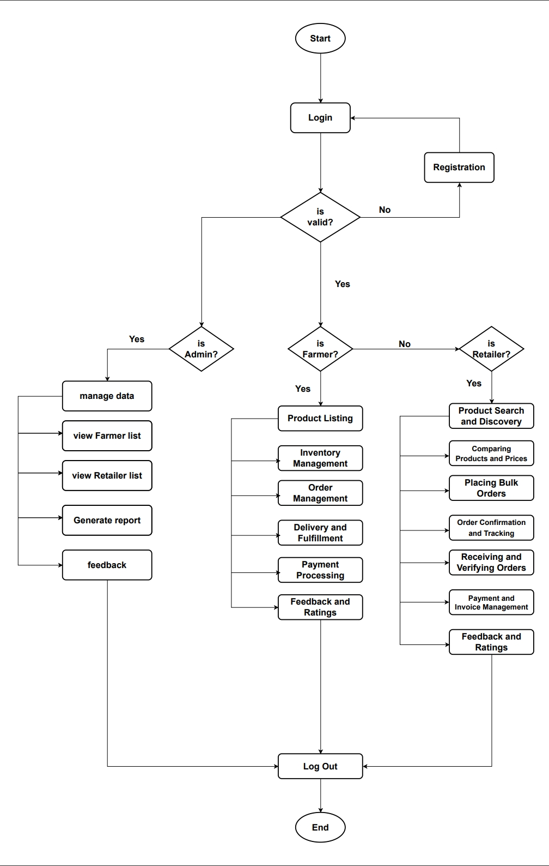
Systemflow Diagram

Slide 9
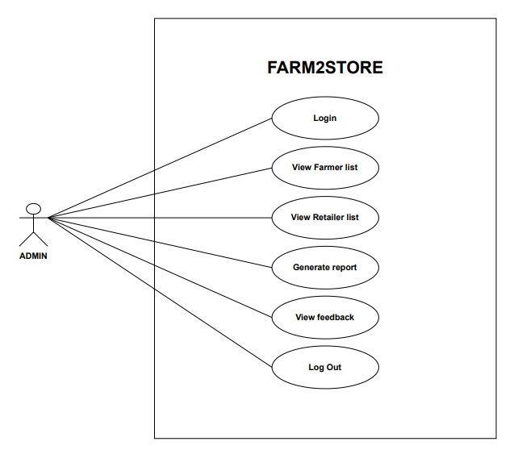
Admin UseCase-Diagram

Slide 10
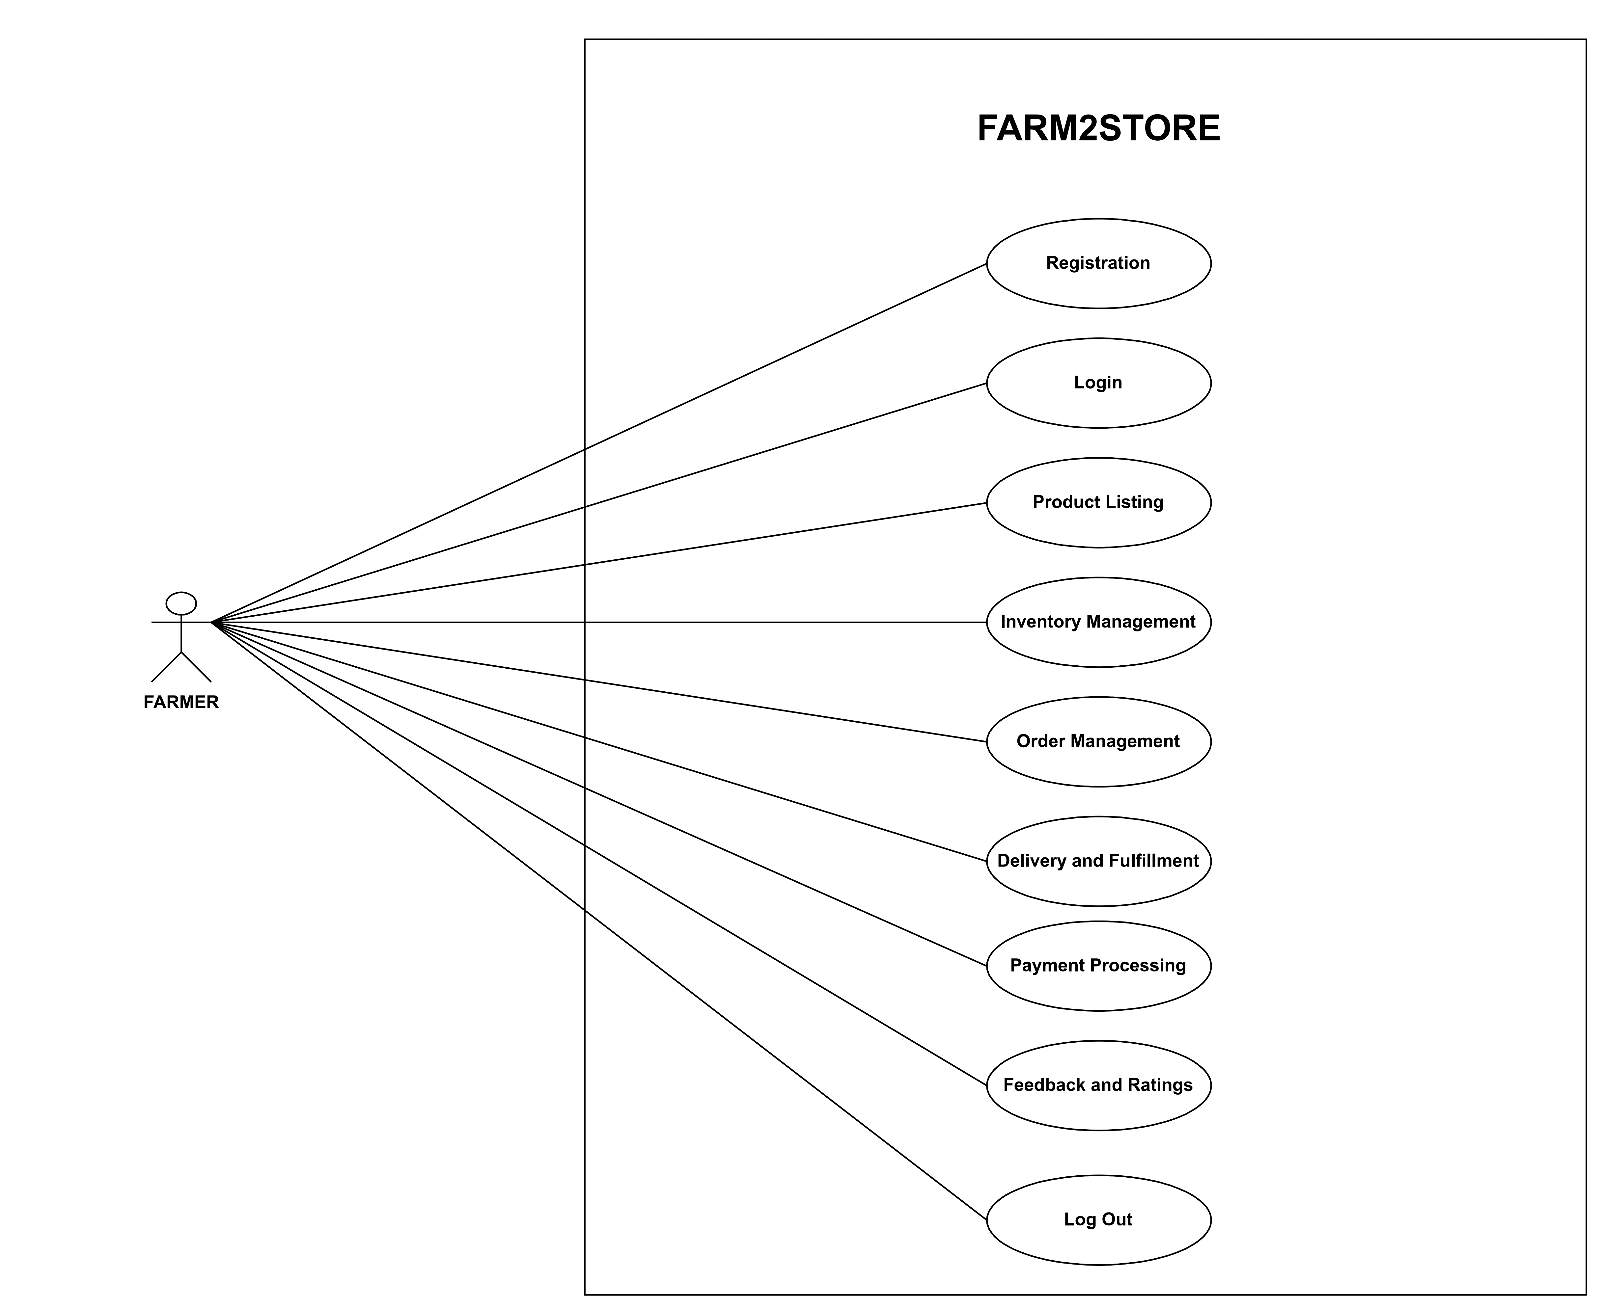
Farmer UseCase-Diagram

Slide 11
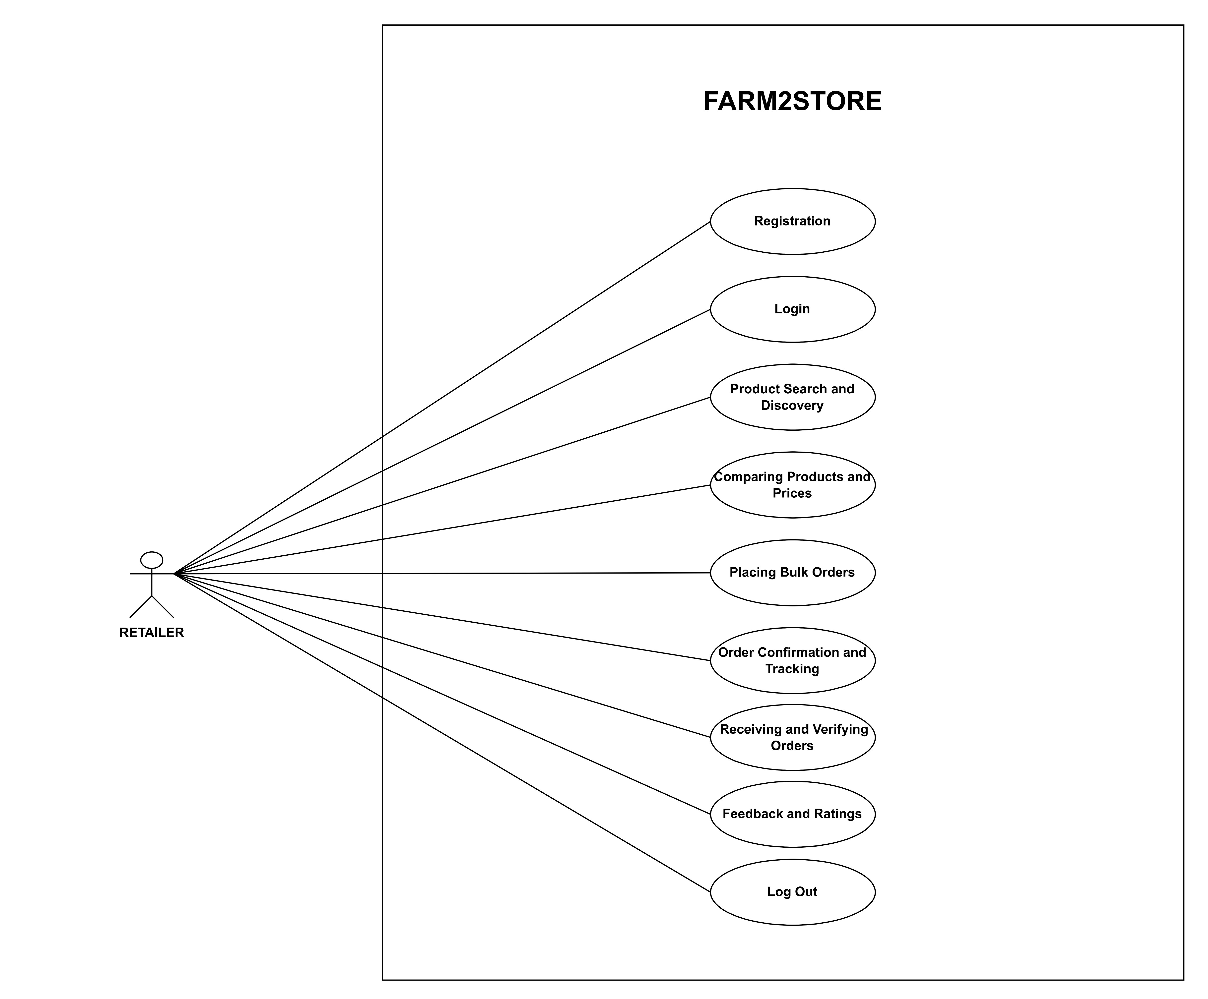
Retailer UseCase-Diagram

Slide 12
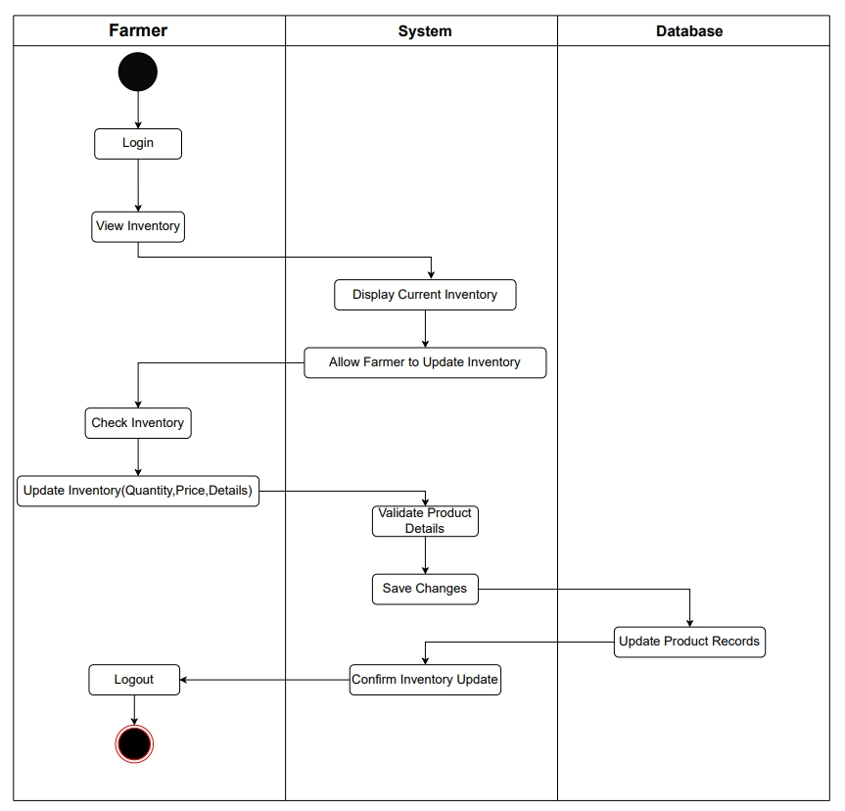
Manage Inventory Activity-Diagram (Farmer)

Slide 13
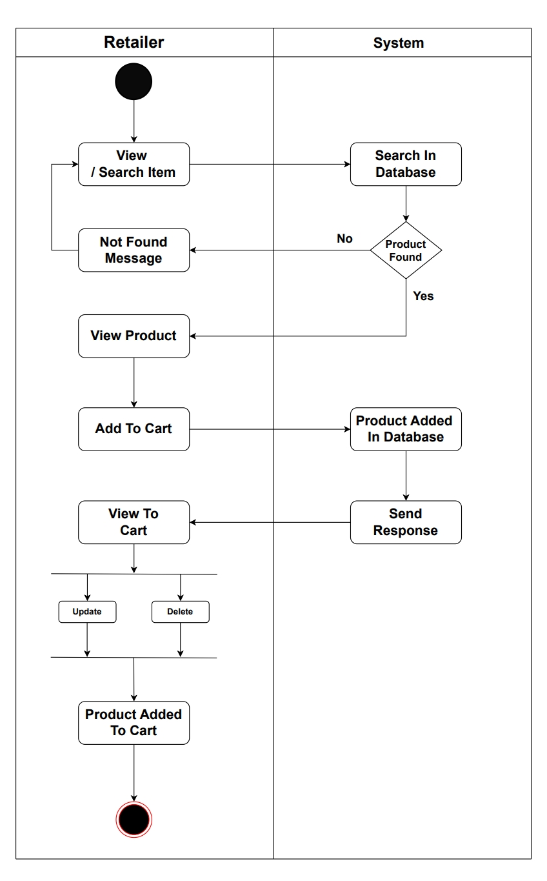
Add To Cart Activity-Diagram (Retailer)

Slide 14
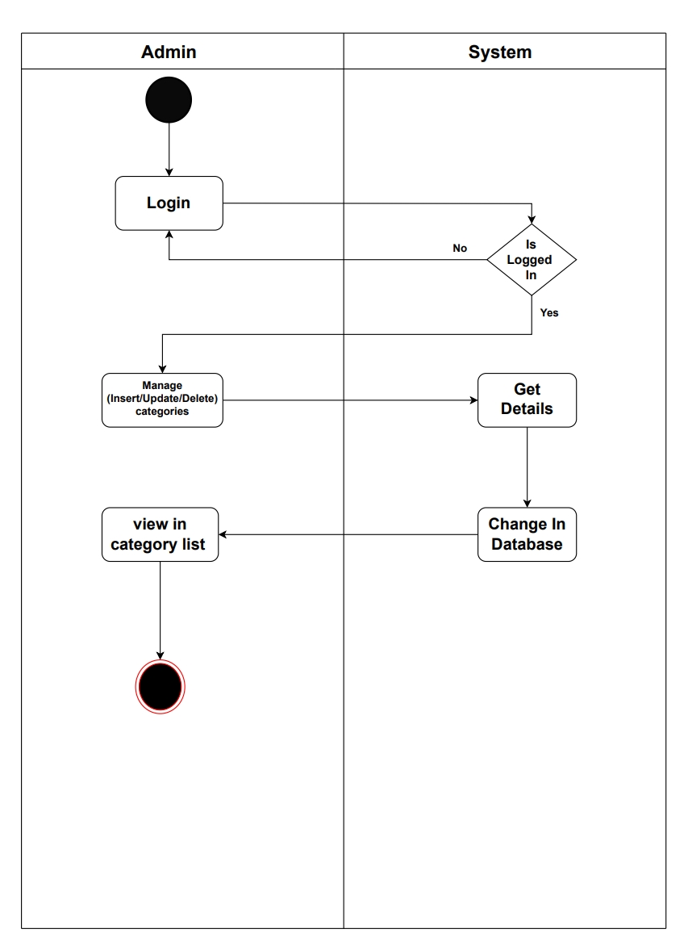
Manage Category Activity-Diagram (Admin)

Slide 15
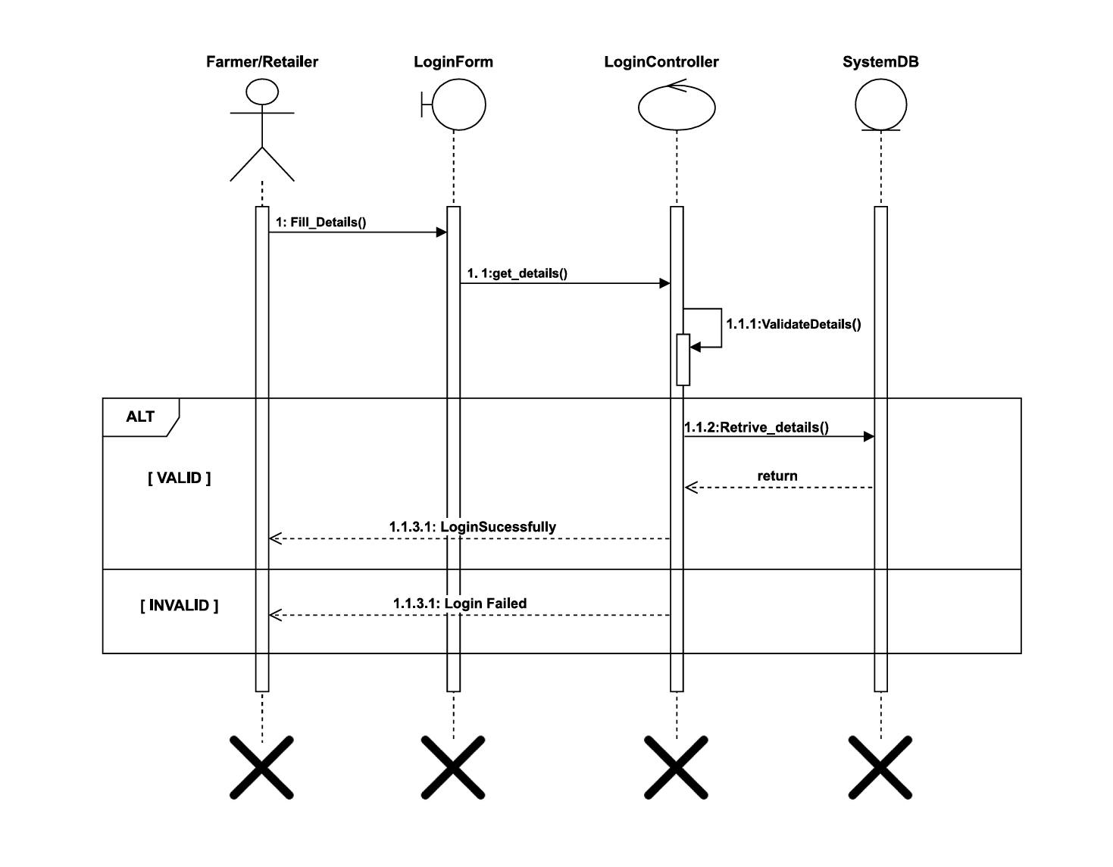
Login Sequence-Diagram (Farmer/Retailer)

Slide 16
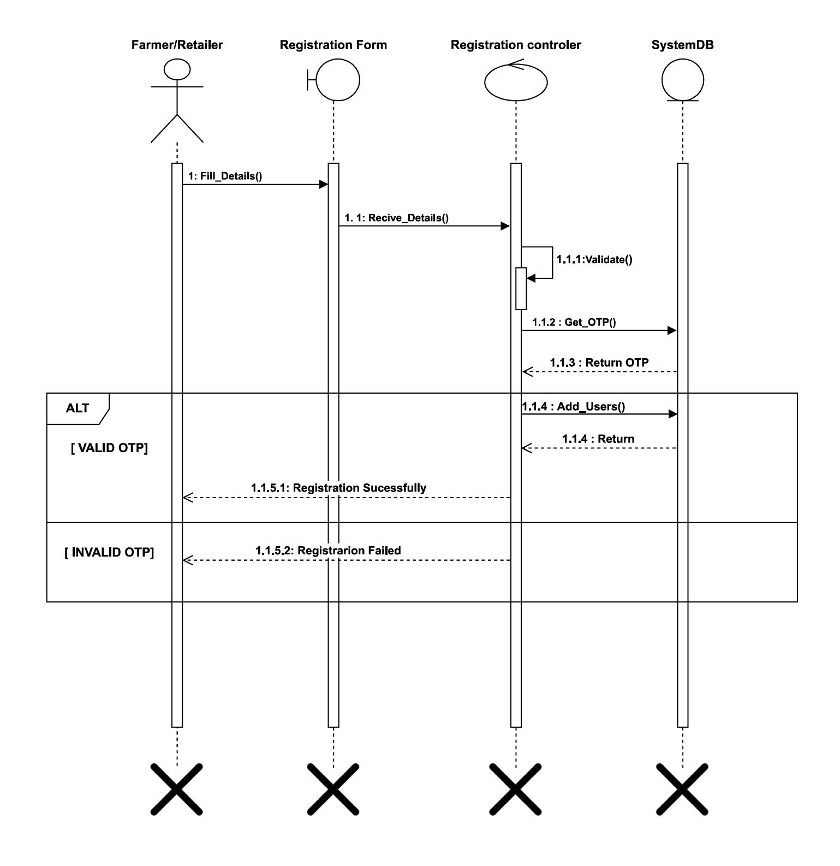
Registration Sequence-Diagram (Farmer/Retailer)

Slide 17
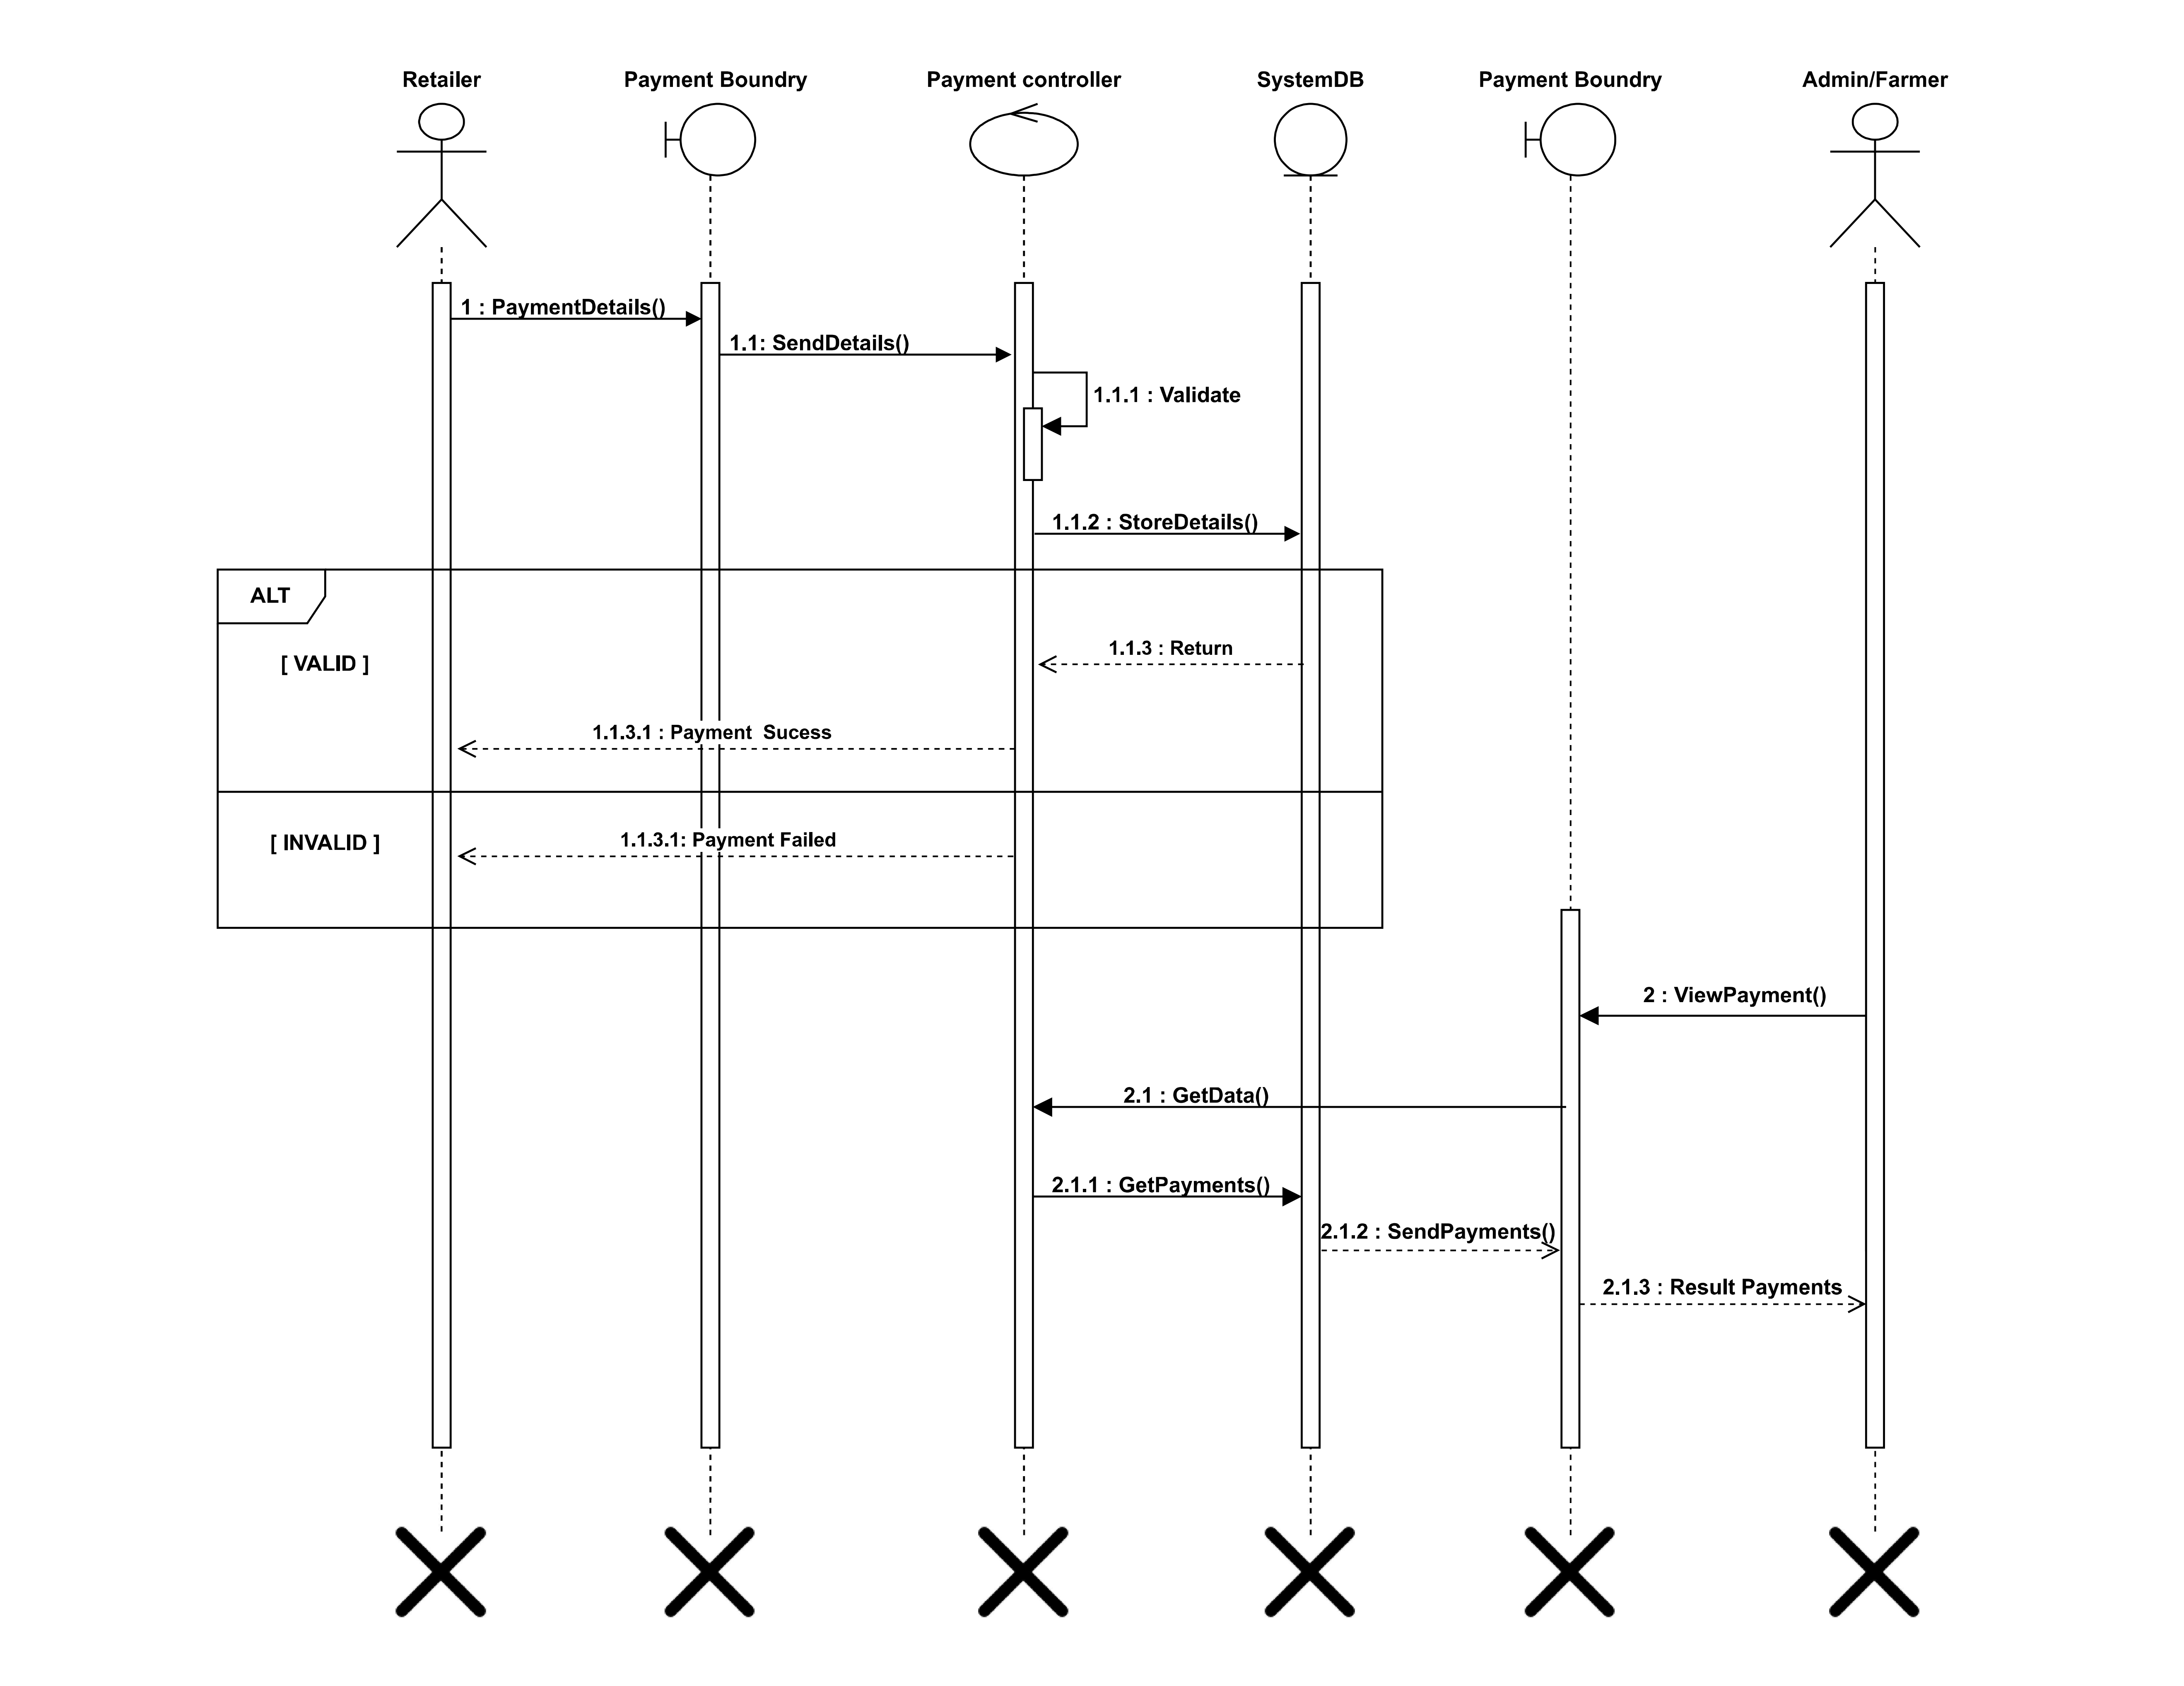
Payment Sequence-Diagram (Retailer)

Slide 18
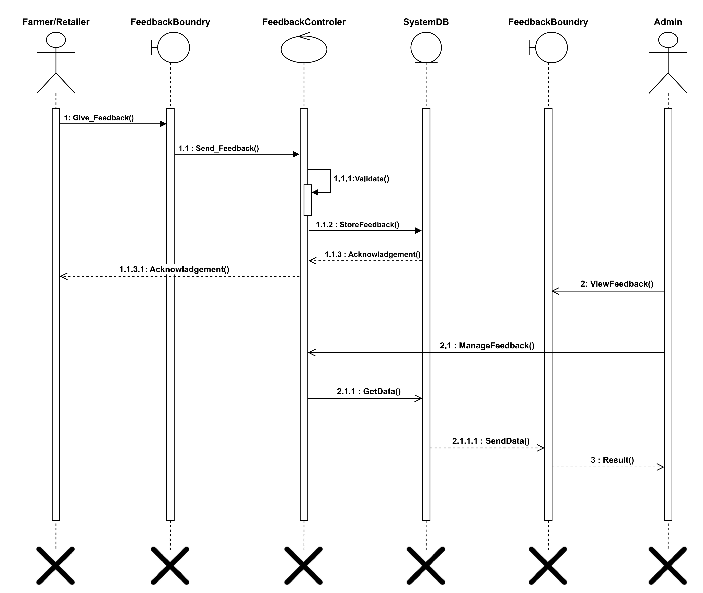
Feedback Sequence-Diagram (Farmer/Retailer)

Slide 19
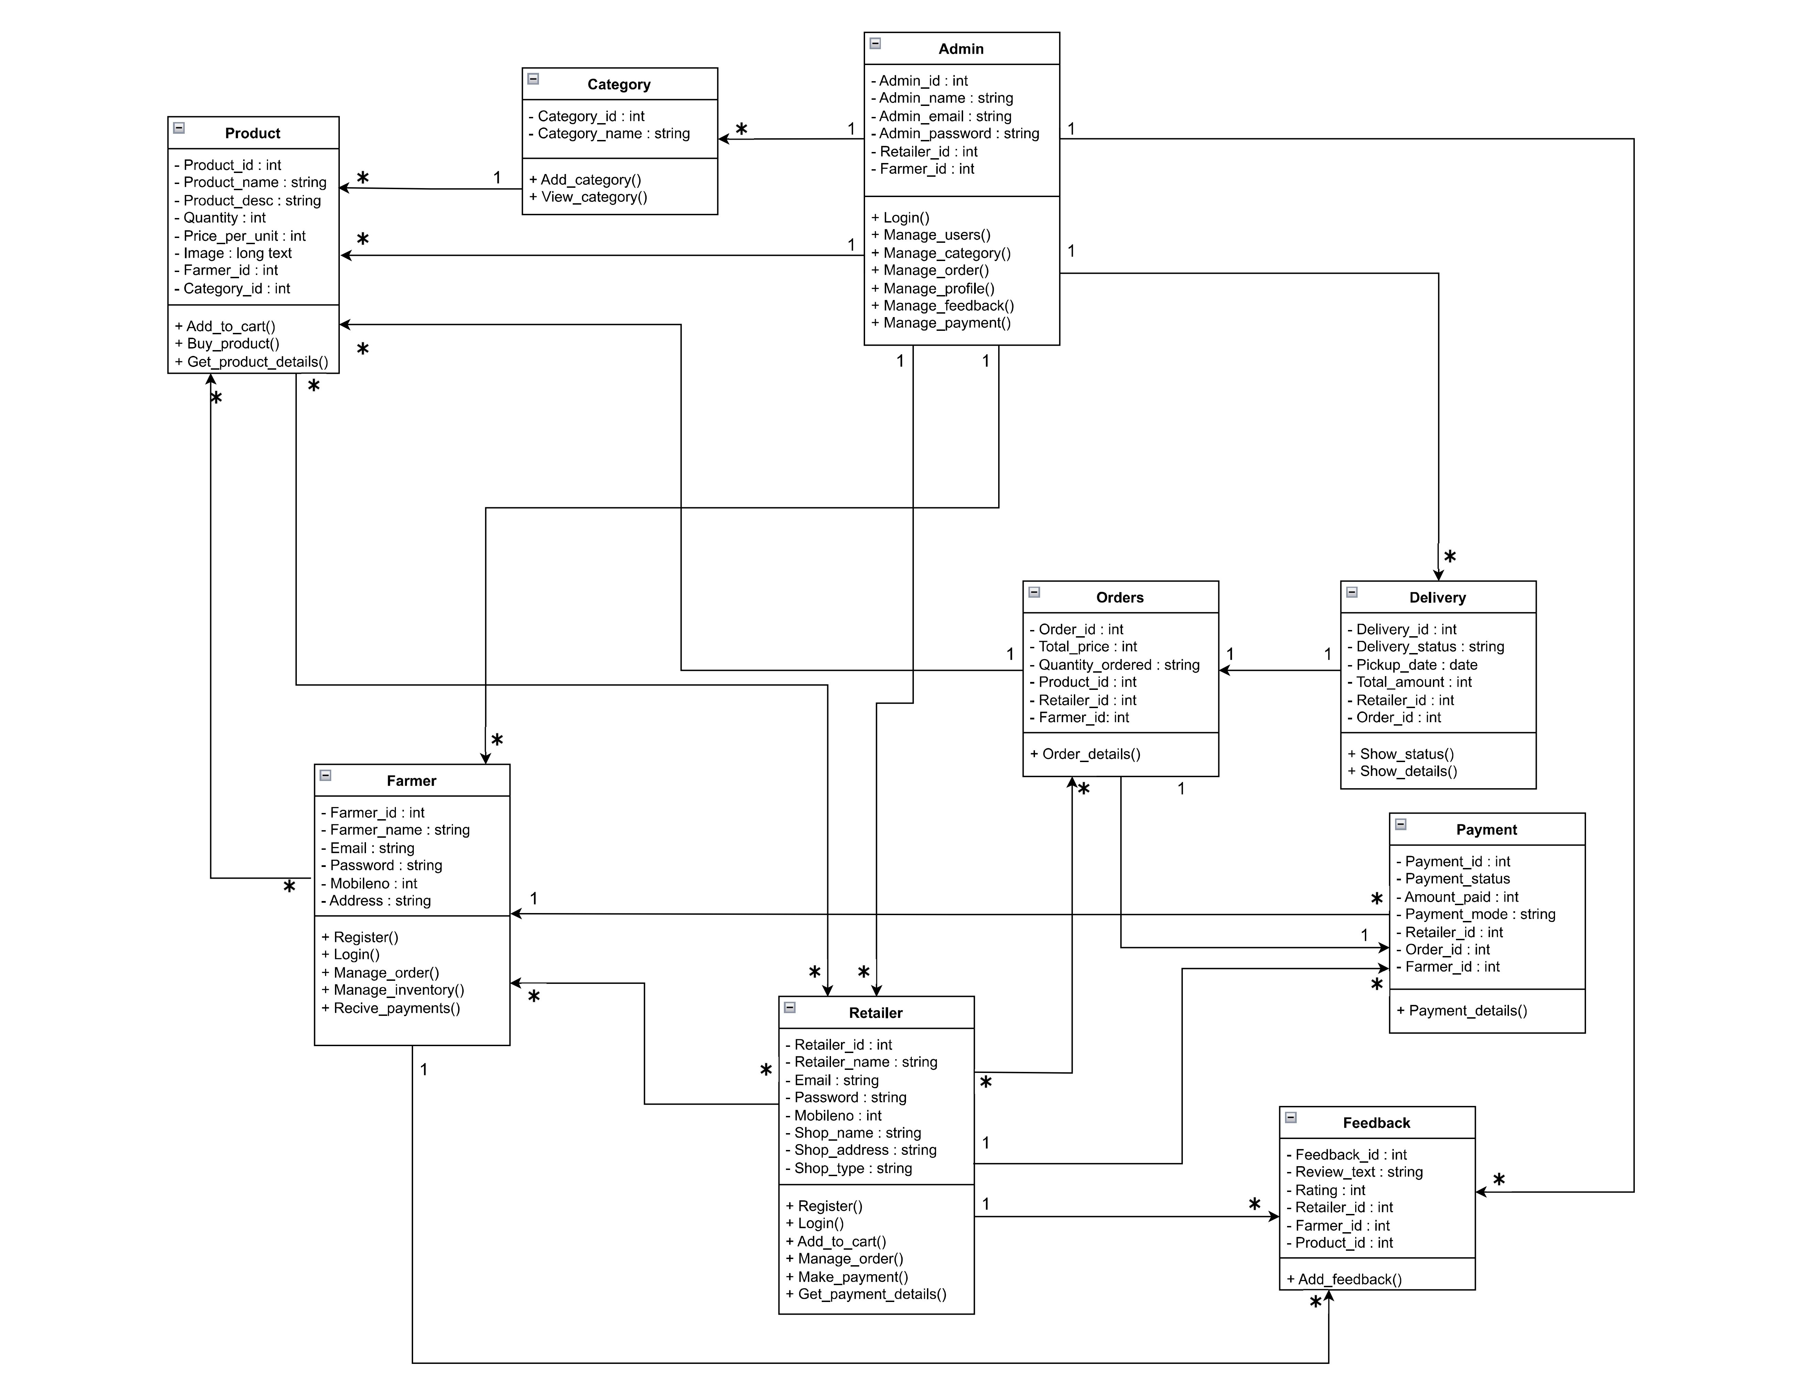
Class-Diagram

Slide 20
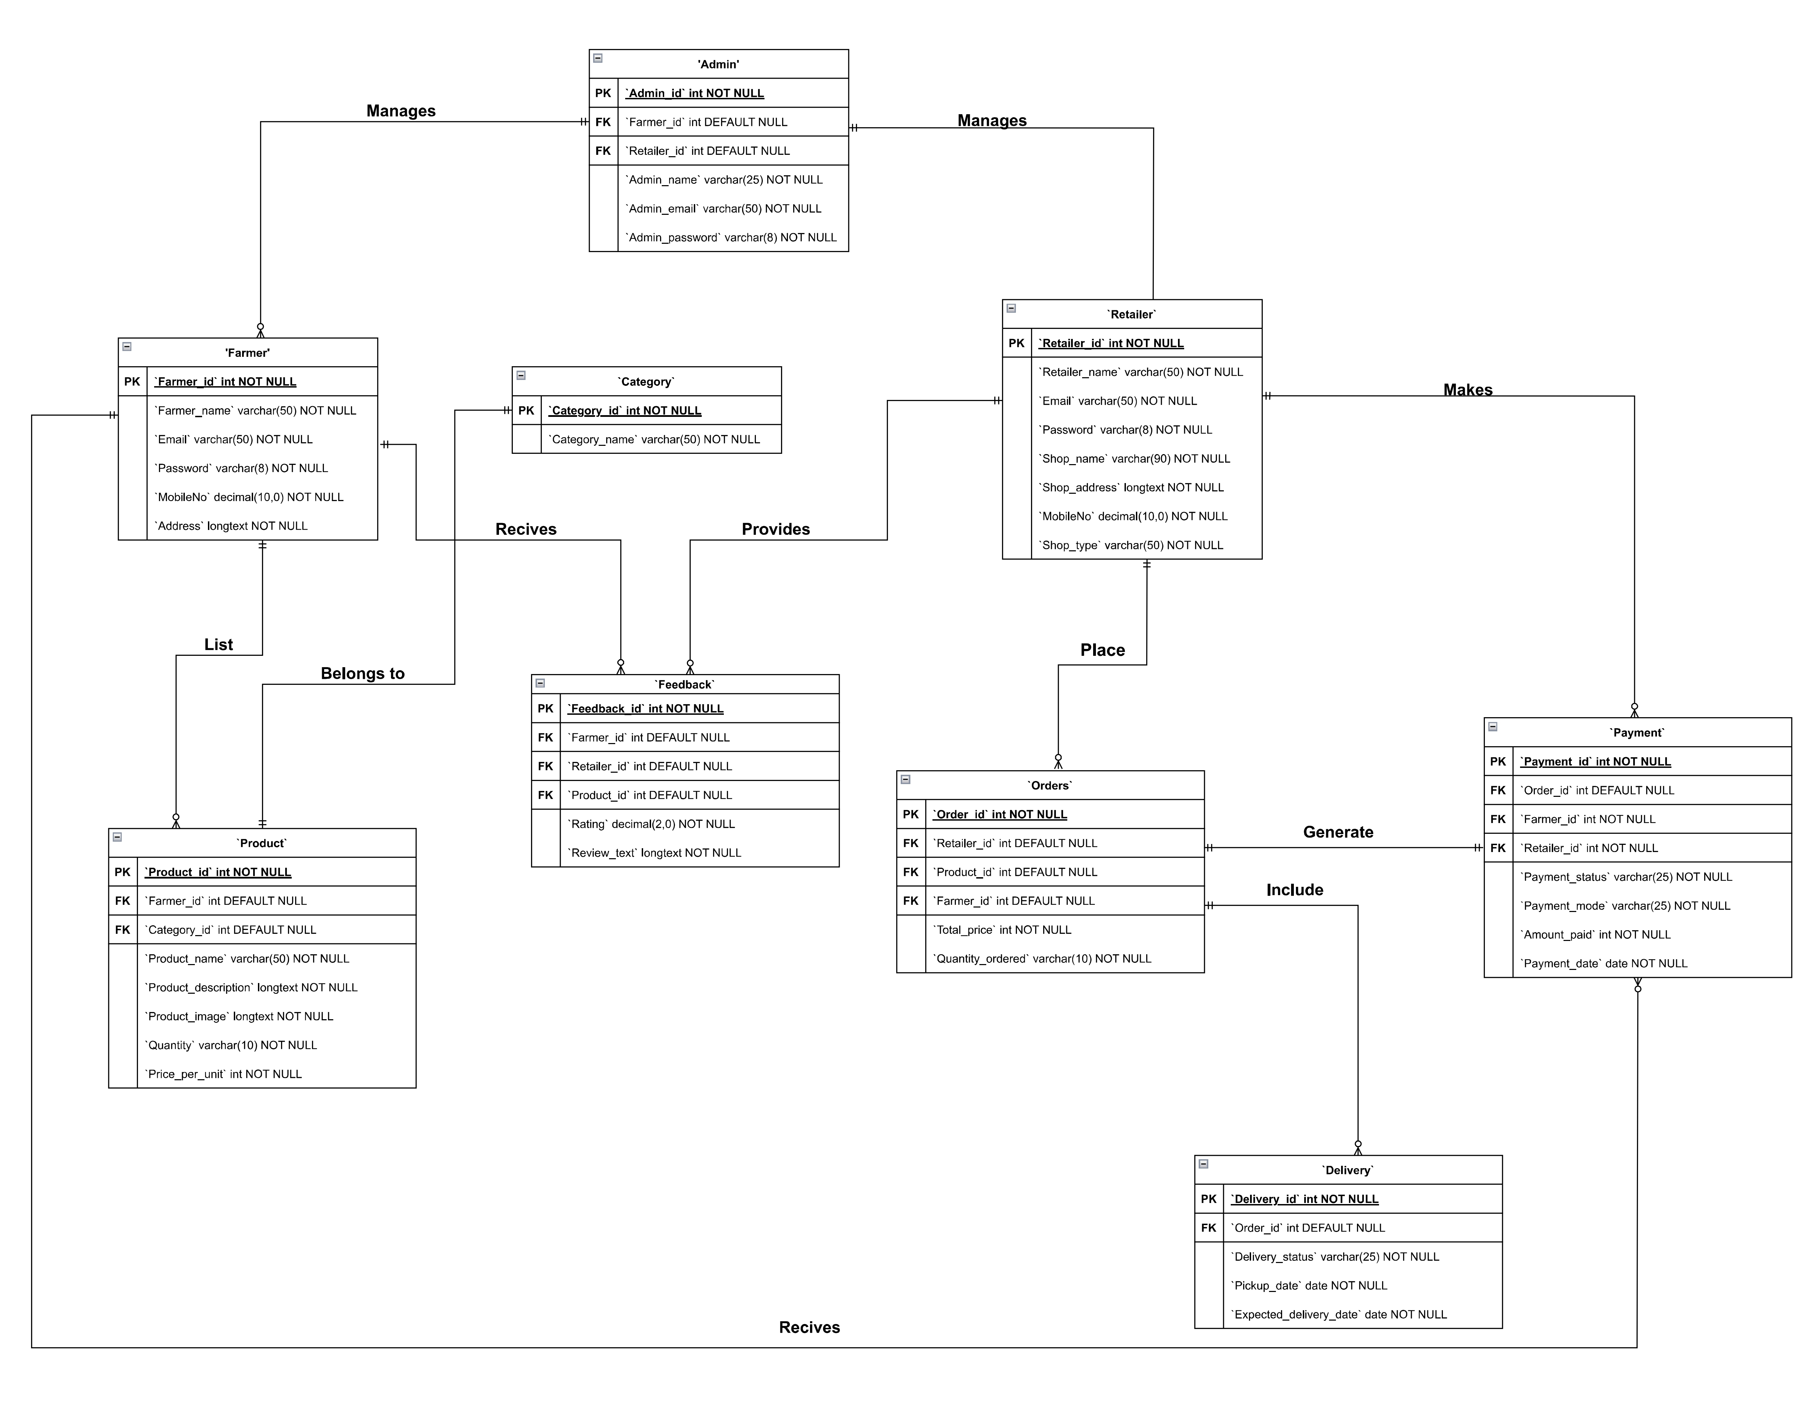
Entity Relationship Diagram

Slide 21
Data Dictionary

Slide 22
1. Admin
ATTRIBURE | CONSTRAIN | DATATYPE | SIZE | DESCRIPTION
ADMIN_ID | PRIMARY KEY | INT |  | PRIMARY KEY FOR ADMIN TABLE, UNIQUE FOR EVERY ROW
ADMIN_NAME | NOT NULL | VARCHAR | 25 | NAME OF ADMIN
ADMIN_EMAIL | NOT NULL | VARCHAR | 50 | ADMIN EMAIL ADDRESS
ADMIN_PASSWORD | NOT NULL | VARCHAR | 8 | ADMIN PASSWORD
RETAILER_ID | FOREIGN KEY | INT |  | MAPPED WITH RETAILER TABLE
FARMER_ID | FOREIGN KEY | INT |  | MAPPED WITH FARMER TABLE

Slide 23
2. Farmer
ATTRIBURE | CONSTRAIN | DATATYPE | SIZE | DESCRIPTION
FARMER_ID | PRIMARY KEY | INT |  | PRIMARY KEY FOR FARMER TABLE,UNIQUE FOR EVERY ROW
FARMER_NAME | NOT NULL | VARCHAR | 50 | NAME OF FARMER
EMAIL | NOT NULL | VARCHAR | 50 | FARMER EMAIL
PASSWORD | NOT NULL | VARCHAR | 8 | FARMER PASSWORD
MOBILENO | NOT NULL | NUMERIC | 10 | FARMER MOBILE NO
ADDRESS | NOT NULL | LONGTEXT |  | FARM ADDRESS

Slide 24
3. Retailer
ATTRIBURE | CONSTRAIN | DATATYPE | SIZE | DESCRIPTION
RETAILER_ID | PRIMARY KEY | INT |  | PRIMARY KEY FOR RETAILER TABLE,UNIQUE FOR EVERY ROW
RETAILER_NAME | NOT NULL | VARCHAR | 50 | NAME OF RETAILER
EMAIL | NOT NULL | VARCHAR | 50 | RETAILER EMAIL
PASSWORD | NOT NULL | VARCHAR | 8 | RETAILER PASSWORD
SHOP_NAME | NOT NULL | VARCHAR | 90 | RETAILER SHOP NAME
SHOP_ADDRESS | NOT NULL | LONGTEXT |  | RETAILER SHOP ADDRESS
MOBILENO | NOT NULL | NUMERIC | 10 | RETAILER MOBILE NO
SHOP_TYPE | NOT NULL | VARCHAR | 50 | RETAILER SHOP TYPE

Slide 25
4. Product
ATTRIBURE | CONSTRAIN | DATATYPE | SIZE | DESCRIPTION
PRODUCT_ID | PRIMARY KEY | INT |  | PRIMARY KEY FOR PRODUCT TABLE,UNIQUE FOR EVERY ROW
PRODUCT_NAME | NOT NULL | VARCHAR | 50 | NAME OF PRODUCT
PRODUCT_DESCRIPTION | NOT NULL | LONGTEXT |  | DESCRIPTION OF PRODUCT
PRODUCT_IMAGE | NOT NULL | LONGTEXT |  | IMAGE OF PRODUCT
QUANTITY | NOT NULL | VARCHAR | 10 | PRODUCT OF QUANTITY
PRICE_PER_UNIT | NOT NULL | INT |  | PRICE PER UNIT OF PRODUCT
FARMER_ID | FOREIGN KEY | INT |  | MAPPED WITH FARMER TABLE
CATEGORY_ID | FOREIGN KEY | INT |  | MAPPED WITH CATEGORY TABLE

Slide 26
6. Orders
5. Category
ATTRIBURE | CONSTRAIN | DATATYPE | SIZE | DESCRIPTION
CATEGORY_ID | PRIMARY KEY | INT |  | PRIMARY KEY FOR CATEGORY TABLE,UNIQUE FOR EVERY ROW
CATEGORY_NAME | NOT NULL | VARCHAR | 50 | NAME OF CATEGORY
ATTRIBURE | CONSTRAIN | DATATYPE | SIZE | DESCRIPTION
ORDER_ID | PRIMARY KEY | INT |  | PRIMARY KEY FOR ORDER TABLE,UNIQUE FOR EVERY ROW
QUANTITY_ORDERED | NOT NULL | VARCHAR | 10 | OAUNTITY OF PRODUCT ORDERED
TOTAL_PRICE | NOT NULL | INT |  | TOTAL PRICE OF ORDER
RETAILER_ID | FOREIGN KEY | INT |  | MAPPED WITH RETAILER TABLE
PRODUCT_ID | FOREIGN KEY | INT |  | MAPPED WITH PRODUCT TABLE
FARMER_ID | FOREIGN KEY | INT |  | MAPPED WITH FARMER TABLE

Slide 27
7. Delivery
ATTRIBURE | CONSTRAIN | DATATYPE | SIZE | DESCRIPTION
DELIVERY_ID | PRIMARY KEY | INT |  | PRIMARY KEY FOR DELIVERY TABLE,UNIQUE FOR EVERY ROW
DELIVERY_STATUS | NOT NULL | VARCHAR | 10 | STATUS OF DELIVERY
PICKUP_DATE | NOT NULL | DATE |  | PICKUP DATE FOR DELIVERY
EXPECTED_DELIVERY_DATE | NOT NULL | DATE |  | EXPECTED DATE FOR DELIVERY
ORDER_ID | FOREIGN KEY | INT |  | MAPPED WITH ORDER TABLE

Slide 28
8. Payment
ATTRIBURE | CONSTRAIN | DATATYPE | SIZE | DESCRIPTION
PAYMENT_ID | PRIMARY KEY | INT |  | PRIMARY KEY FOR PAYMENT TABLE,UNIQUE FOR EVERY ROW
PAYMENT_STATUS | NOT NULL | VARCHAR | 25 | STATUS OF PAYMENT
PAYMENT_MODE | NOT NULL | VARCHAR | 25 | MODE OF PAYMENT
AMOUNT_PAID | NOT NULL | INT |  | AMOUNT PAID FOR ORDER
PAYMENT_DATE | NOT NULL | DATE |  | DATE OF PAYMENT
RETAILER_ID | FOREIGN KEY | INT |  | MAPPED WITH RETAILER TABLE
FARMER_ID | FOREIGN KEY | INT |  | MAPPED WITH FARMER TABLE
ORDER_ID | FOREIGN KEY | INT |  | MAPPED WITH ORDER TABLE

Slide 29
9. Feedback
ATTRIBURE | CONSTRAIN | DATATYPE | SIZE | DESCRIPTION
FEEDBACK_ID | PRIMARY KEY | INT |  | PRIMARY KEY FOR FEEDBACK TABLE,UNIQUE FOR EVERY ROW
RATING | NOT NULL | INT | 2 | RATING FOR PRODUCT
REVIEW_TEXT | NOT NULL | LONGTEXT |  | REVIEW FOR ORDERS
PRODUCT_ID | FOREIGN KEY | INT |  | MAPPED WITH PRODUCT TABLE
RETAILER_ID | FOREIGN KEY | INT |  | MAPPED WITH RETAILER TABLE
FARMER_ID | FOREIGN KEY | INT |  | MAPPED WITH FARMER TABLE

Slide 30
Thank You

